Slide 1
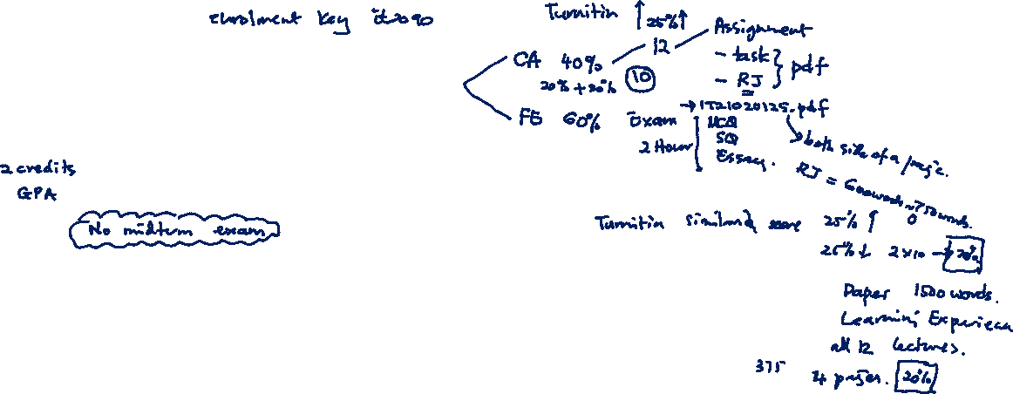
Personal Development Planning
Prof. Koliya Pulasinghe

Slide 2
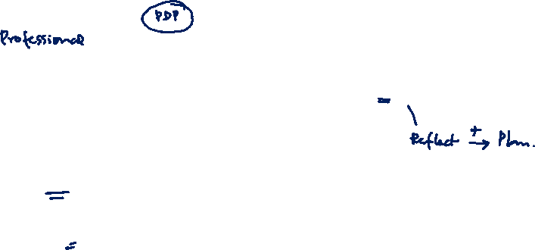
Agenda
Personal Development Planning
Reflective Practice
SWOT Analysis
Planning

Slide 3
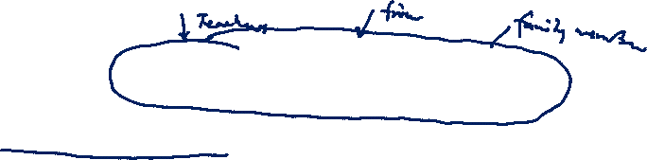
Personal Development Planning
Why we need PDP?
Industry is rapidly changing, if we don’t change/develop we will become obsolete
Taking personal responsibility over self development – It is our responsibility to develop ourselves
Notes:
Area that lecturer is covering, You can see the text book,

Slide 4

Personal Development Planning
PDP is a record of achievements, learning experiences and plans
It is prepared in order to recognise your achievements, understand how you gained your existing skills, plan to enhance them further and develop new ones
Notes:
Area that lecturer is covering, You can see the text book,

Slide 5
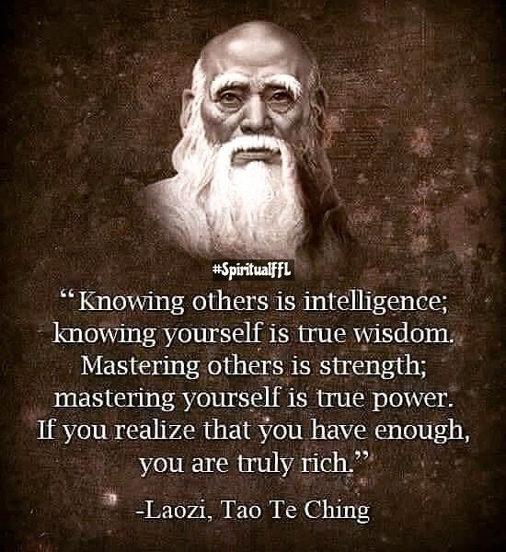
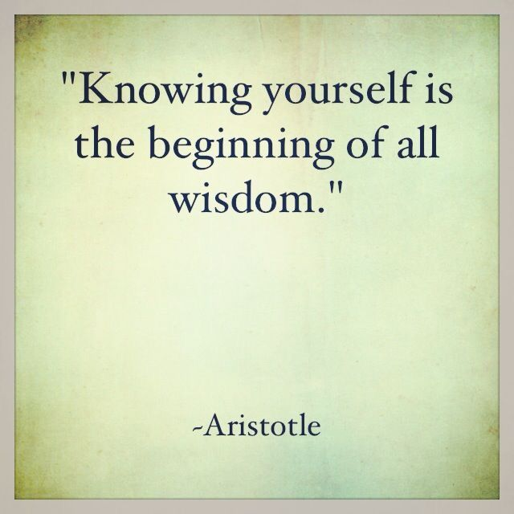
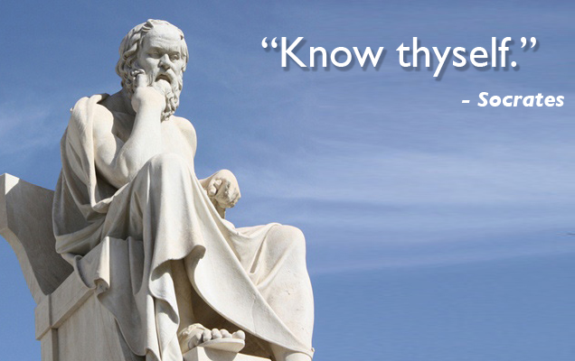
Personal Development Planning

Slide 6
Personal Development Planning
PDP is driven by:
Reflecting: how past skills are gained, reasons on successes and failures
Planning: how you are going to develop a certain skill that you want or need to face the future/to complete your degree, follow a specific career or achieve a personal goal
Notes:
Area that lecturer is covering, You can see the text book,

Slide 7
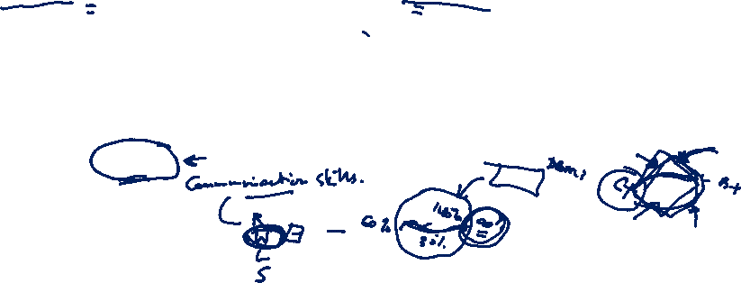
Personal Development Planning
It involves you building up a record of achievements, personal reflections and plans for self-improvement
The more you practise PDP, you are aware of your skills, the more developed they will become
the better your sense of personal achievement your focus on your goals/gaps
Notes:
Area that lecturer is covering, You can see the text book,

Slide 8
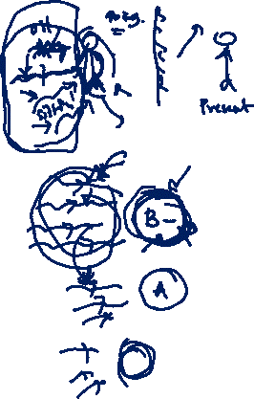
Reflective Practice
In order to learn effectively it is not enough to simply have an experience
In order to maximise the learning potential of the situation before it is lost, we need to reflect on the experience
Reflecting is an important stage of the PDP process
You need to reflect in order to improve and develop your skills and knowledge; the idea is that you learn from your successes and mistakes
Notes:
Planning has to be reviewed, daily, weekly and annually. Drawbacks should be identified and rectified.

Slide 9
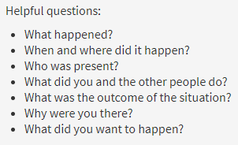
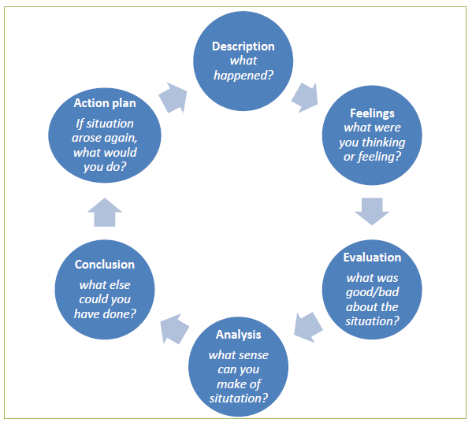
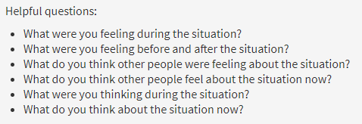

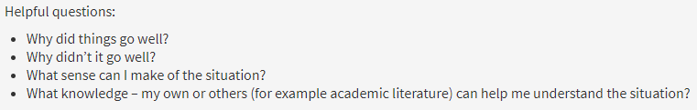
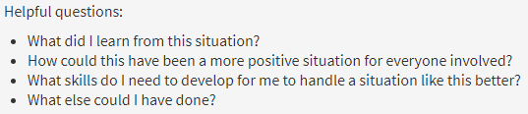
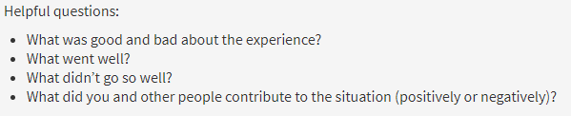
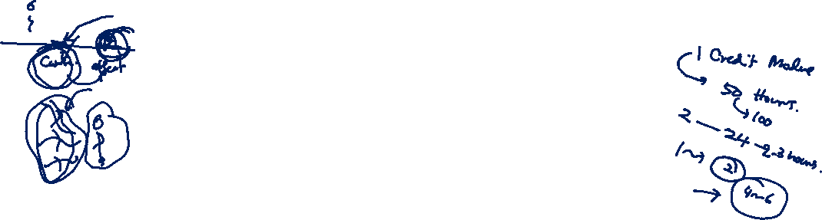
Gibb’s Reflective Cycle
https://www.ed.ac.uk/reflection/reflectors-toolkit/reflecting-on-experience/gibbs-reflective-cycle

Slide 10



Slide 11
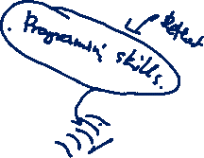
Personal Development Plan
In professional world this is called as professional development plan
Starts with a goal or a gap analysis
Ex: Goal Setting:
Want to get A+ for SE
Improve Body Mass Index from 28 to 25 (Gap 3 units)
Prepare a strategic plan to achieve your target
Use SWOT Analysis
SW Internal Factors, OT External Factors
SO Favourable (Helps you to achieve your goals)
WT Unfavourable (Blocks your progress)

Slide 12
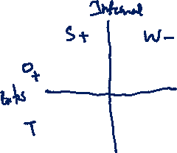
SWOT Analysis
A SWOT Analysis is a tool for identifying your Strengths and Weaknesses, and for examining the Opportunities and Threats to your goals
SWOT Analysis helps you to focus your activities into areas where you are strong and where the greatest opportunities lie
Notes:
Planning has to be reviewed, daily, weekly and annually. Drawbacks should be identified and rectified.

Slide 13
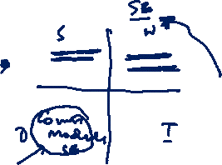
SWOT Analysis
What skills or experience do you already possess? Give examples to evidence these if you can.
What do you do well?
What do other people see as being your strengths? Consider this from your own point of view and from the point of view of the people who know you. Don't be modest - be realistic.
If you are having any difficulty with this, try writing down a list of your characteristics. Some of these will probably be strengths.
Strengths
Notes:
Planning has to be reviewed, daily, weekly and annually. Drawbacks should be identified and rectified.

Slide 14
SWOT Analysis
What could you improve on?
What do you do badly?
What should you avoid?
Do other people consider you to have weaknesses that you do not agree with? Why do they think that? Do you see weaknesses in yourself that others do not see as being a problem?
Weaknesses
Notes:
Planning has to be reviewed, daily, weekly and annually. Drawbacks should be identified and rectified.

Slide 15
SWOT Analysis
What resources are available to you?
Consider the networking opportunities that will be available to you. How will you make best use of these?
What are the interesting trends you are aware of in the graduate employment market?
How can you develop yourself according to these?
Are there any other learning opportunities, in addition to those offered by your degree programme, that you are interested in exploring?
Opportunities
Notes:
A useful approach to looking at opportunities is to look at your strengths and ask yourself whether these open up any
opportunities. Alternatively, look at your weaknesses and ask whether you could find opportunities to eliminate them.

Slide 16
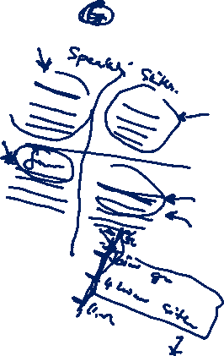
SWOT Analysis
What obstacles do you face?
Could any of your weaknesses seriously threaten your opportunities? What are they?
Do you have past experience of trying and failing to achieve your goals?
Threats
Notes:
Planning has to be reviewed, daily, weekly and annually. Drawbacks should be identified and rectified.

Slide 17
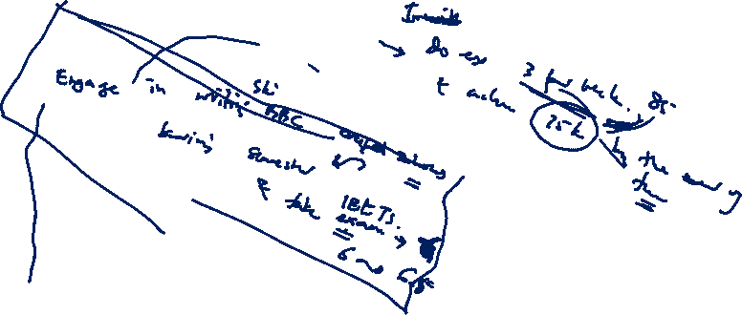
Plan (Strategies)
SMART
Specific
Measurable
Achievable
Relevant
Time Bound

Slide 18
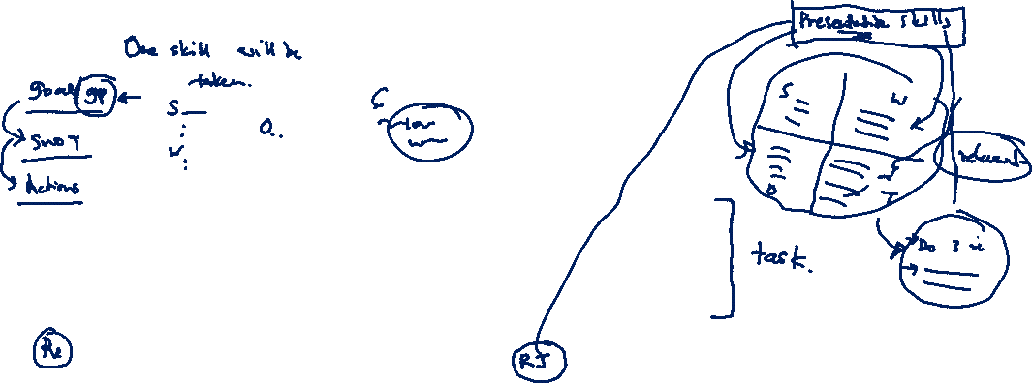
PDP
Exercise 1
Set a goal or understand a gap in your skills
Do a SWOT by keeping that goal/gap in mind
Write down strategies to achieve the goal/gap
Exercise 2
Write a reflective journal
Prepare a pdf with your student ID as the file name. Upload the pdf to course-web before midnight 20th July, 2021.

Slide 19
Final Words
Form a habit of doing this regularly when you see a gap in your skills
Or
When you set a target for life

Slide 20
Thank You

